Slide 1
Introduction to Compartmental (Dynamical/Mechanistic/Mathematical) Models
Cara Brook
University of Chicago
With some material borrowed from :
Sophia Horigan, University of Chicago
Amy Wesolowski, Johns Hopkins University
Jessica Metcalf, Princeton University
Steve Bellan, University of Georgia
Notes:
-salama daholo, Sophia no anarako
-I’m a phd student in cara’s lab at Uchicago, and I’m both a field and computational biologist interested in infectious diseases at the human wildlife interface
-very excited to be here today to talk about compartmental models
-this lecture will take us until lunch, then after lunch we’ll come back to do the R tutorial where we’ll get to apply some of the concepts we’ve learned today
-I’m going to do my best to speak slowly but I tend to talk fast when I get excited, so please don’t hesitate to raise your hands if you have any questions or want me to repeat anything
-I’ve built in a few check in points to help with this, but please interrupt me anytime
-we’ve included the French translation through many parts of this powerpoint, and Santino is standing by if anyone wants to discuss anything in Malagasy
-any questions? Alright let’s go!
-first off, how many of you have heard of compartmental modeling? Or used it in your research? (maybe ask what for)

Slide 2
Goals for this lecture
Understand the difference between statistical and mechanistic models Comprendre la différence entre les modèles statistiques et mécanistes.
Understand how to formalize and conceptualize compartmental models Comprendre comment on peut formuler et conceptualiser les modèles compartimentés
Example: population growth, predator prey, SIR models
Notes:
I’m going to start us off with some goals for the lecture, some key concepts that are the fundamental building blocks of compartmental modeling
If any of these words/concepts aren’t familiar to you, don’t worry, by the end of this time you’ll be very familiar!

Slide 3
Goals for this lecture
Understand the difference between statistical and mechanistic models Comprendre la différence entre les modèles statistiques et mécanistes.
Understand how to formalize and conceptualize compartmental models Comprendre comment on peut formuler et conceptualiser les modèles compartimentés
Example: population growth, predator prey, SIR models

Slide 4
Goals for this lecture
Understand the difference between statistical and mechanistic models Comprendre la différence entre les modèles statistiques et mécanistes.
Understand how to formalize and conceptualize compartmental models Comprendre comment on peut formuler et conceptualiser les modèles compartimentés
Example: population growth, predator prey, SIR models

Slide 5
Goals for this lecture
Understand the difference between statistical and mechanistic models Comprendre la différence entre les modèles statistiques et mécanistes.
Understand how to formalize and conceptualize compartmental models Comprendre comment on peut formuler et conceptualiser les modèles compartimentés
Example: population growth, predator prey, SIR models

Slide 6

?/?/? Models
Notes:
Going to start off with what a compartmental model is
There’s a lot of terminology in modeling, and so I want to point out that when we say compartmental model, we can also say mechanistic model, or mathematical model

Slide 7
Compartmental/Mechanistic/Mathematical/Dynamical Models
Notes:
Going to start off with what a compartmental model is
There’s a lot of terminology in modeling, and so I want to point out that when we say compartmental model, we can also say mechanistic model, or mathematical model

Slide 8
Compartmental/Mechanistic/Mathematical Models
Populations are divided into compartments Les populations sont subdivisées en compartiments
Individuals within a compartment are homogeneously mixed Les individus d'un compartiment sont mélangés de manière homogène
Compartments and transition rates are determined by biological systems Les compartiments et les taux de transition sont déterminés par les systèmes biologiques
Rates of transferring between compartments are expressed mathematically Taux de transition entre les compartiments sont exprimés mathématiquement

Slide 9
Compartmental/Mechanistic/Mathematical Models
Populations are divided into compartments Les populations sont subdivisées en compartiments
Individuals within a compartment are homogeneously mixed Les individus d'un compartiment sont mélangés de manière homogène
Compartments and transition rates are determined by biological systems Les compartiments et les taux de transition sont déterminés par les systèmes biologiques
Rates of transferring between compartments are expressed mathematically Taux de transition entre les compartiments sont exprimés mathématiquement

Slide 10
Compartmental/Mechanistic/Mathematical Models
Populations are divided into compartments Les populations sont subdivisées en compartiments
Individuals within a compartment are homogeneously mixed Les individus d'un compartiment sont mélangés de manière homogène
Compartments and transition rates are determined by biological systems Les compartiments et les taux de transition sont déterminés par les systèmes biologiques
Rates of transferring between compartments are expressed mathematically Taux de transition entre les compartiments sont exprimés mathématiquement

Slide 11
Compartmental/Mechanistic/Mathematical Models
Populations are divided into compartments Les populations sont subdivisées en compartiments
Individuals within a compartment are homogeneously mixed Les individus d'un compartiment sont mélangés de manière homogène
Compartments and transition rates are determined by biological systems Les compartiments et les taux de transition sont déterminés par les systèmes biologiques
Rates of transferring between compartments are expressed mathematically Taux de transition entre les compartiments sont exprimés mathématiquement
Notes:
These are the FOUR GOLDEN RULES, and for the rest of the lecture, we’re going to see how we can apply these four golden rules to different questions to build models

Slide 12
How are these different from statistical models? En quoi sont-ils différents des modèles statistiques?
Make explicit hypotheses about biological mechanisms that drive infection dynamics (may not be realistic, but still explicit)
Faire des hypothèses explicites sur les mécanismes biologiques qui régissent la dynamique de l'infection (peut ne pas être réaliste, mais toujours explicite)

Slide 13
How are these different from statistical models? En quoi sont-ils différents des modèles statistiques?
Make explicit hypotheses about biological mechanisms that drive dynamics (may not be realistic, but still explicit)
Faire des hypothèses explicites sur les mécanismes biologiques qui régissent la dynamique de l'infection (peut ne pas être réaliste, mais toujours explicite)

Slide 14
1. Simple Population Models 1. Modèles simples de population

Slide 15
Madagascar
What can we say about the population of Madagascar?
How would a model help us? What kind of model should we use?
http://databank.worldbank.org
Notes:
This plot shows the population of Madagascar over time, from 1960 to 2010.
Just by looking at it we can learn a few things:
it’s increasing
It looks like its increasing more and more quickly over time
Just looking at it is helpful, but if we want to A) understand exactly how it’s changing over time, and B) be able to predict future change, we can create a compartmental model that captures these dynamics
And this type of model is of course, a basic population model

Slide 16
The basic
population model
Compartmental models (Mechanistic Models)
Populations are divided into compartments
Individuals within a compartment are homogenously mixed
3. Compartments and transition rates are
determined by biological systems
4. Rates of transferring between compartments
are expressed mathematically
Compartmental models (Mechanistic Models)
1. Les populations sont subdivisées en compartiments
2. Les individus d'un compartiment sont mélangés de manière homogène
3. Les compartiments et les taux de transition sont déterminés par les systèmes biologiques
4. Taux de transition entre les compartiments sont exprimés mathématiquement
Notes:
So the basic population model has to follow the same rules of all compartmental models that we talked about a few minutes ago
First,

Slide 17
The basic
population model
Compartmental models (Mechanistic Models)
Populations are divided into compartments
Individuals within a compartment are homogenously mixed
3. Compartments and transition rates are
determined by biological systems
4. Rates of transferring between compartments
are expressed mathematically
Compartmental models (Mechanistic Models)
1. Les populations sont subdivisées en compartiments
2. Les individus d'un compartiment sont mélangés de manière homogène
3. Les compartiments et les taux de transition sont déterminés par les systèmes biologiques
4. Taux de transition entre les compartiments sont exprimés mathématiquement

Slide 18
The basic
population model
Compartmental models (Mechanistic Models)
Populations are divided into compartments
Individuals within a compartment are homogenously mixed
3. Compartments and transition rates are
determined by biological systems
4. Rates of transferring between compartments
are expressed mathematically
Compartmental models (Mechanistic Models)
1. Les populations sont subdivisées en compartiments
2. Les individus d'un compartiment sont mélangés de manière homogène
3. Les compartiments et les taux de transition sont déterminés par les systèmes biologiques
4. Taux de transition entre les compartiments sont exprimés mathématiquement

Slide 19
The basic
population model
Compartmental models (Mechanistic Models)
Populations are divided into compartments
Individuals within a compartment are homogenously mixed
3. Compartments and transition rates are
determined by biological systems
4. Rates of transferring between compartments
are expressed mathematically
Compartmental models (Mechanistic Models)
1. Les populations sont subdivisées en compartiments
2. Les individus d'un compartiment sont mélangés de manière homogène
3. Les compartiments et les taux de transition sont déterminés par les systèmes biologiques
4. Taux de transition entre les compartiments sont exprimés mathématiquement

Slide 20
The basic
population model
Compartmental models (Mechanistic Models)
1. Populations are divided into compartments
2. Compartments and transition rates are
determined by biological systems
3. Rates of transferring between compartments
are expressed mathematically
4. Individuals within a compartment are homogenously mix
How does the population of Madagascar grow over time?
Comment est-ce que la population de Madagascar s’augmente avec le passage du temps?
Notes:
If we are able to make a model that follows all of those rules, we’ll be able to answer our core question: how does the population mof Madagascar grow over time?
So let’s walk through how we can implement each of these rules

Slide 21

The simplest population model
1. Populations are divided into compartments
2. Individuals within a compartment are homogenously mixed
3. Compartments and transition rates are
determined by biological systems
4. Rates of transferring between compartments
are expressed mathematically
Madagascar
(N)

Slide 22
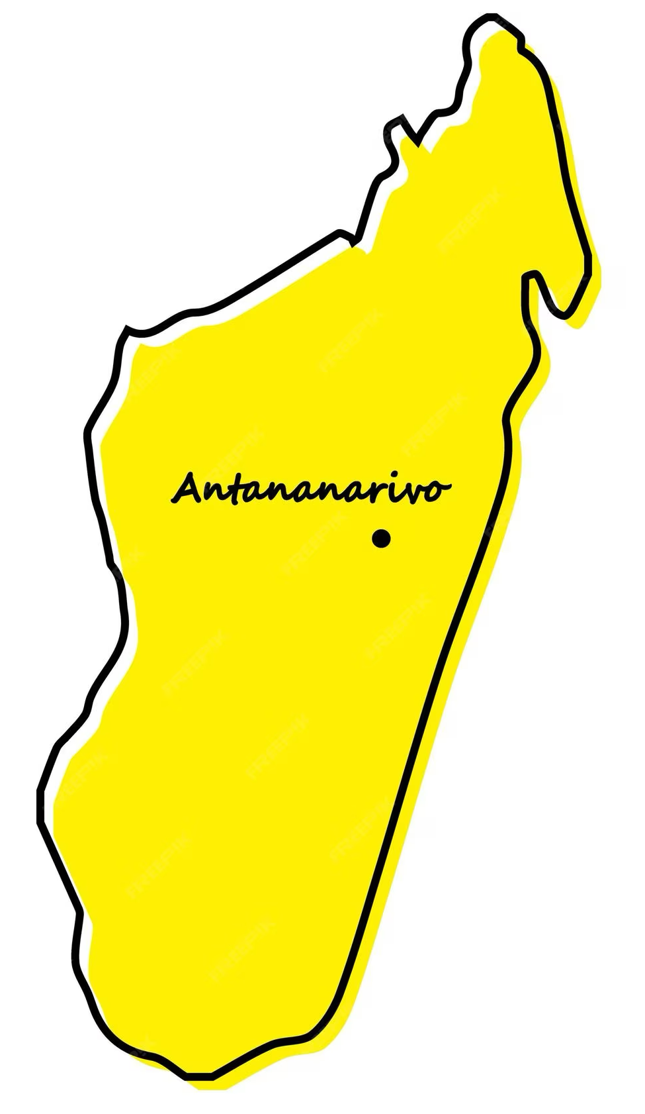
The simplest population model
1. Populations are divided into compartments
2. Individuals within a compartment are homogenously mixed
3. Compartments and transition rates are
determined by biological systems
4. Rates of transferring between compartments
are expressed mathematically
Madagascar
(N)

Slide 23
The simplest population model
1. Populations are divided into compartments
2. Individuals within a compartment are homogenously mixed
3. Compartments and transition rates are
determined by biological systems
4. Rates of transferring between compartments
are expressed mathematically
Madagascar
(N)
How does the population grow?

Slide 24
The simplest population model
1. Populations are divided into compartments
2. Individuals within a compartment are homogenously mixed
3. Compartments and transition rates are
determined by biological systems
4. Rates of transferring between compartments
are expressed mathematically
births
Madagascar
(N)
How does the population grow?

Slide 25
The simplest population model
1. Populations are divided into compartments
2. Individuals within a compartment are homogenously mixed
3. Compartments and transition rates are
determined by biological systems
4. Rates of transferring between compartments
are expressed mathematically
births
Madagascar
(N)
deaths
How does the population decrease?

Slide 26
The simplest population model
1. Populations are divided into compartments
2. Individuals within a compartment are homogenously mixed
3. Compartments and transition rates are
determined by biological systems
4. Rates of transferring between compartments
are expressed mathematically
births
PROCESSES
Madagascar
(N)
deaths
STATES

Slide 27
The simplest population model
1. Populations are divided into compartments
2. Individuals within a compartment are homogenously mixed
3. Compartments and transition rates are
determined by biological systems
4. Rates of transferring between compartments
are expressed mathematically
births
Madagascar
(N)
deaths
N_{t+1}= N_{t} + births*N_{t}-deaths*N_{t}

Slide 28
The simplest population model
1. Populations are divided into compartments
2. Individuals within a compartment are homogenously mixed
3. Compartments and transition rates are
determined by biological systems
4. Rates of transferring between compartments
are expressed mathematically
births
Madagascar
(N)
deaths
N_{t+1}= N_{t} + births*N_{t}-deaths*N_{t}
N_{t+1}= N_{t} + (births-deaths)*N_{t}

Slide 29
The simplest population model
1. Populations are divided into compartments
2. Individuals within a compartment are homogenously mixed
3. Compartments and transition rates are
determined by biological systems
4. Rates of transferring between compartments
are expressed mathematically
births
Madagascar
(N)
deaths
N_{t+1}= N_{t} + births*N_{t}-deaths*N_{t}
N_{t+1}= N_{t} + (births-deaths)*N_{t}
R=geometric rate of increase R = (births – deaths)
N_{t+1}= N_{t} + R*N_{t}
(pop grows @ R > 0 & declines @ R < 0 )

Slide 30
The simplest population model
1. Populations are divided into compartments
2. Individuals within a compartment are homogenously mixed
3. Compartments and transition rates are
determined by biological systems
4. Rates of transferring between compartments
are expressed mathematically
births
Madagascar
(N)
deaths
N_{t+1}= N_{t} + births*N_{t}-deaths*N_{t}
N_{t+1}= N_{t} + R*N_{t}
λ= population rate of increase
(finite growth rate)
λ=1+R
N_{t+1}= (1+ R)*N_{t}
N_{t+1}=λ*N_{t}
Notes:
Lambda is the growth rate of a discrete population

Slide 31
The simplest population model
1. Populations are divided into compartments
2. Individuals within a compartment are homogenously mixed
3. Compartments and transition rates are
determined by biological systems
4. Rates of transferring between compartments
are expressed mathematically
births
Madagascar
(N)
deaths
N_{t+1}= N_{t} + births*N_{t}-deaths*N_{t}
N_{t+1}= N_{t} + R*N_{t}
λ= population rate of increase
(finite growth rate)
N_{t+1}= (1+ R)*N_{t}
N_{t+1}=λ*N_{t}
(pop grows @ λ >1 & declines @ λ < 1 )

Slide 32
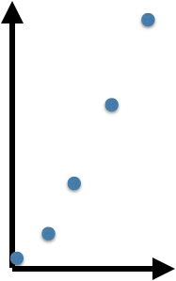
births
Madagascar
(N)
deaths
Geometric growth
Geometric growth is measured in discrete time
λ=N_{t+1}/N_{t}
N₁= 𝜆N₀
N₂= 𝜆[𝜆N₀]=𝜆²N₀
N₃= 𝜆³N₀
N_{t}= 𝜆^{t}N₀
λ=population rate of increase

Slide 33
Is discrete time realistic for population growth?

Slide 34
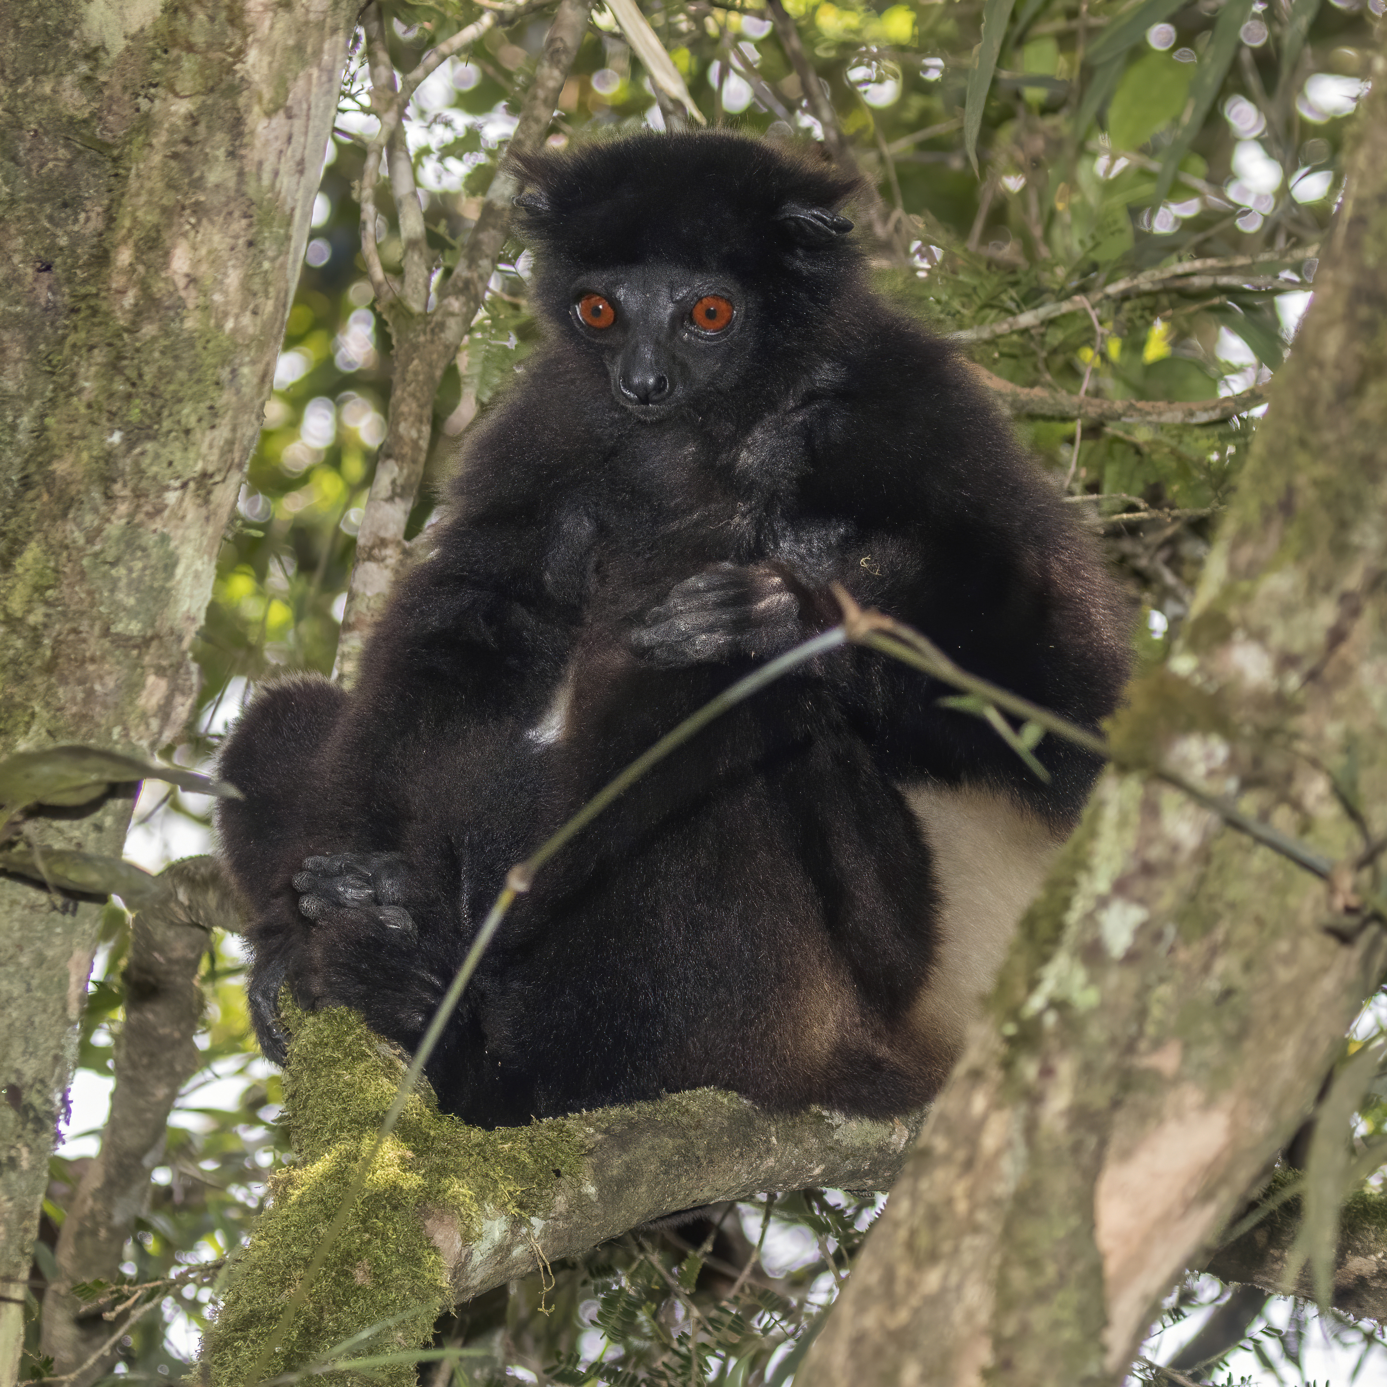
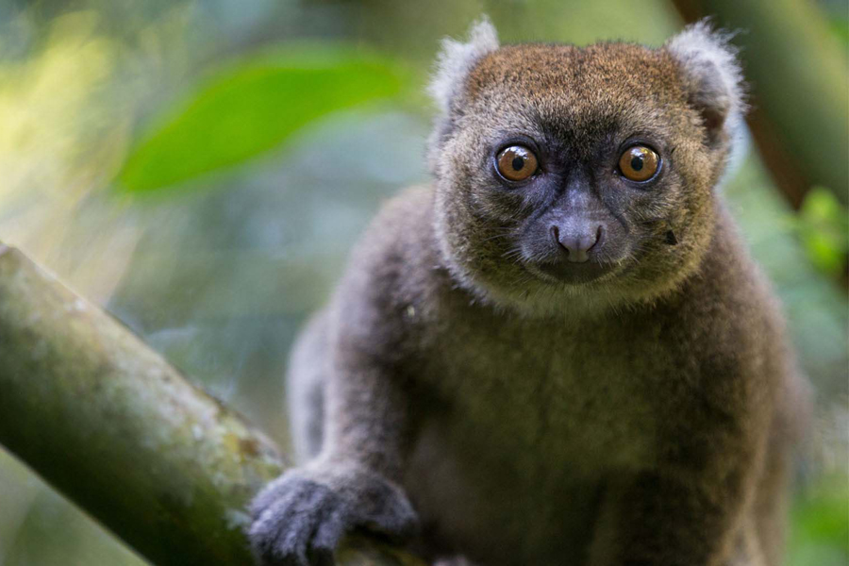
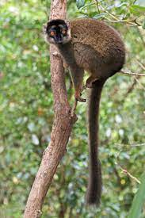
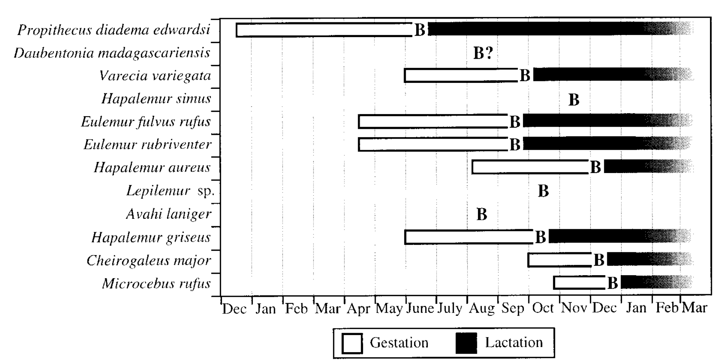
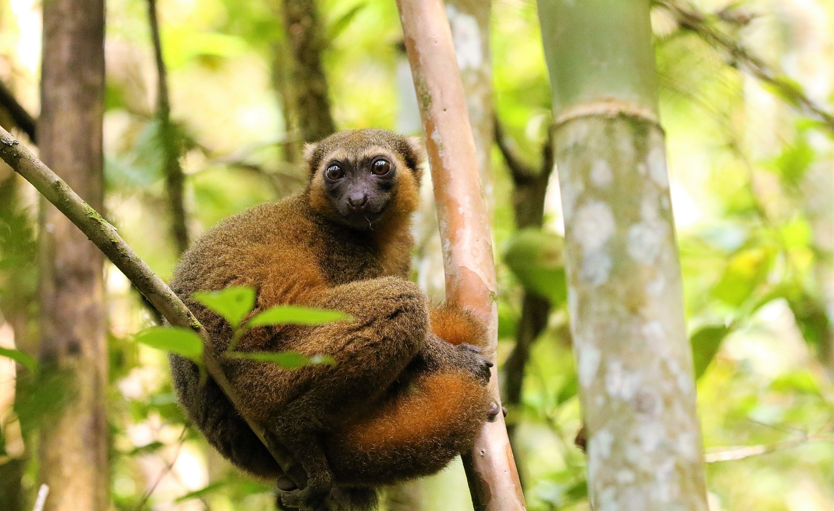
Is discrete time realistic for population growth?
Wright 1999. Am J of Phys Anthr.
Notes:
Lemur breeding by month synchronizes weaning at peak fruit

Slide 35
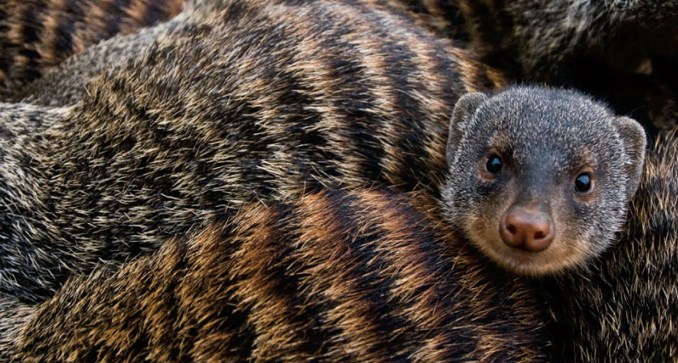
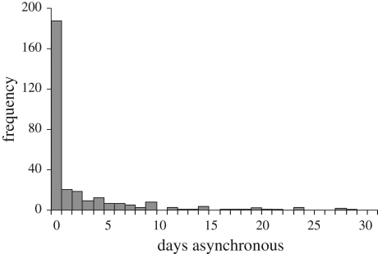
Is discrete time realistic for population growth?
64% of banded mongoose pups are born on the same day.
Hodge et al. 2011. Biology Letters.
Notes:
Infanticide by mother vs. competition with other siblings. Safest to be harder to distinguish parentage apart

Slide 36
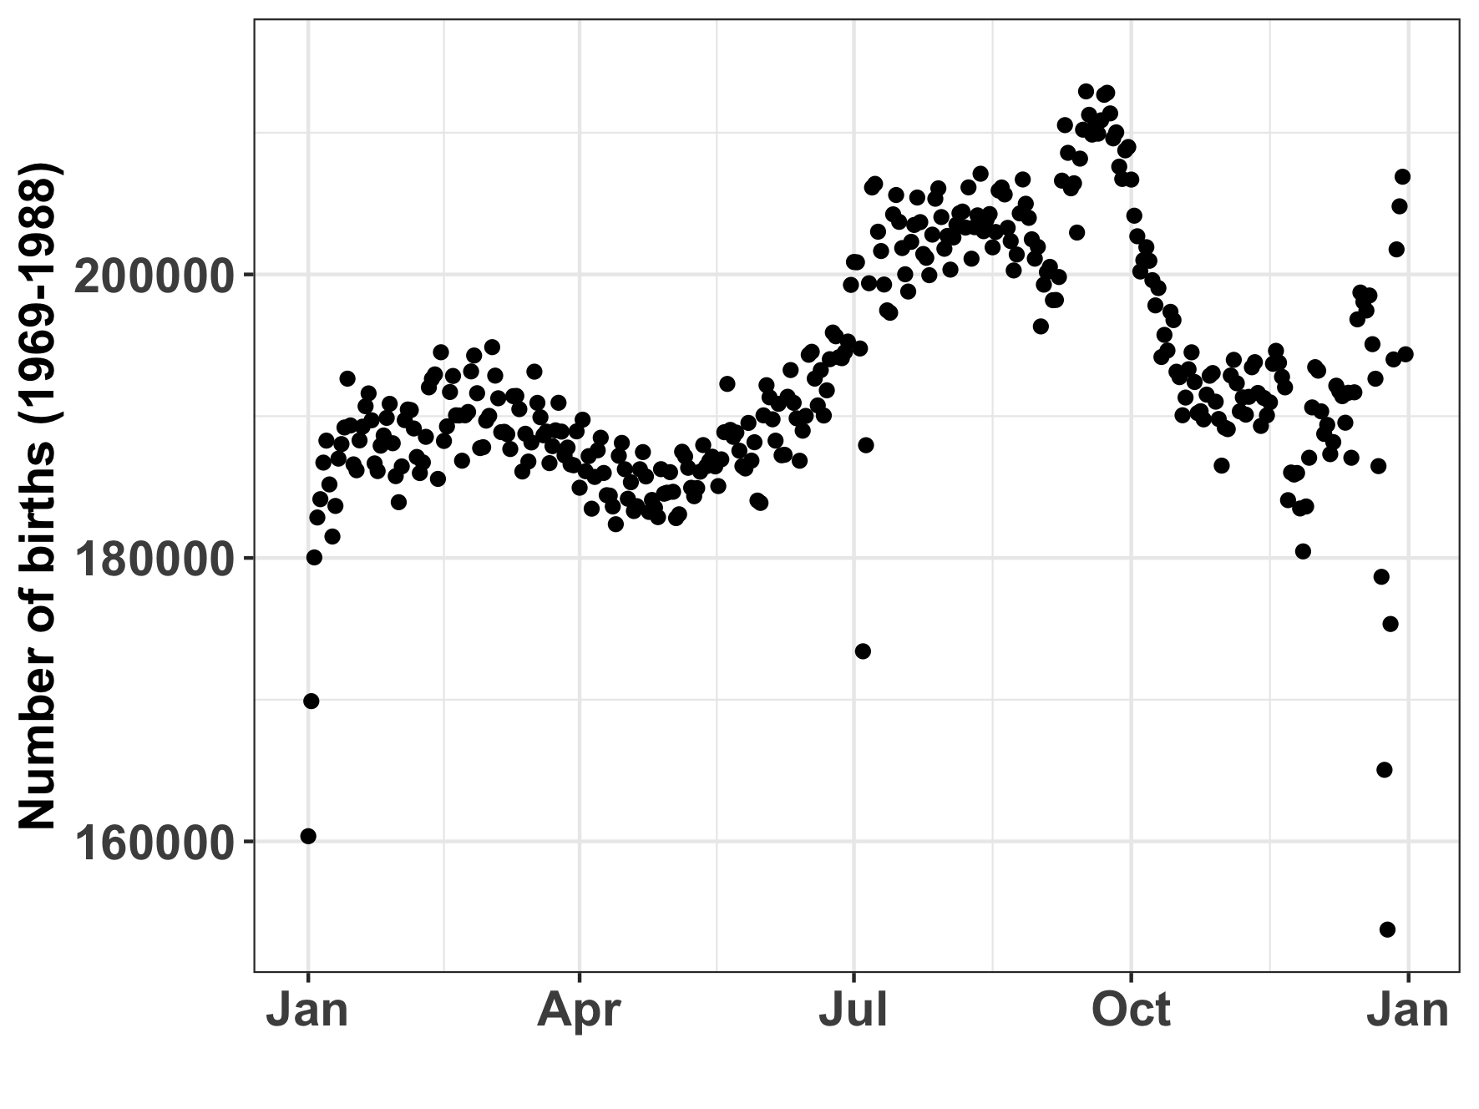
Is discrete time realistic for population growth?
Human births by day in the US
(1969-1988)
Notes:
Infanticide by mother vs. competition with other siblings. Safest to be harder to distinguish parentage apart

Slide 37
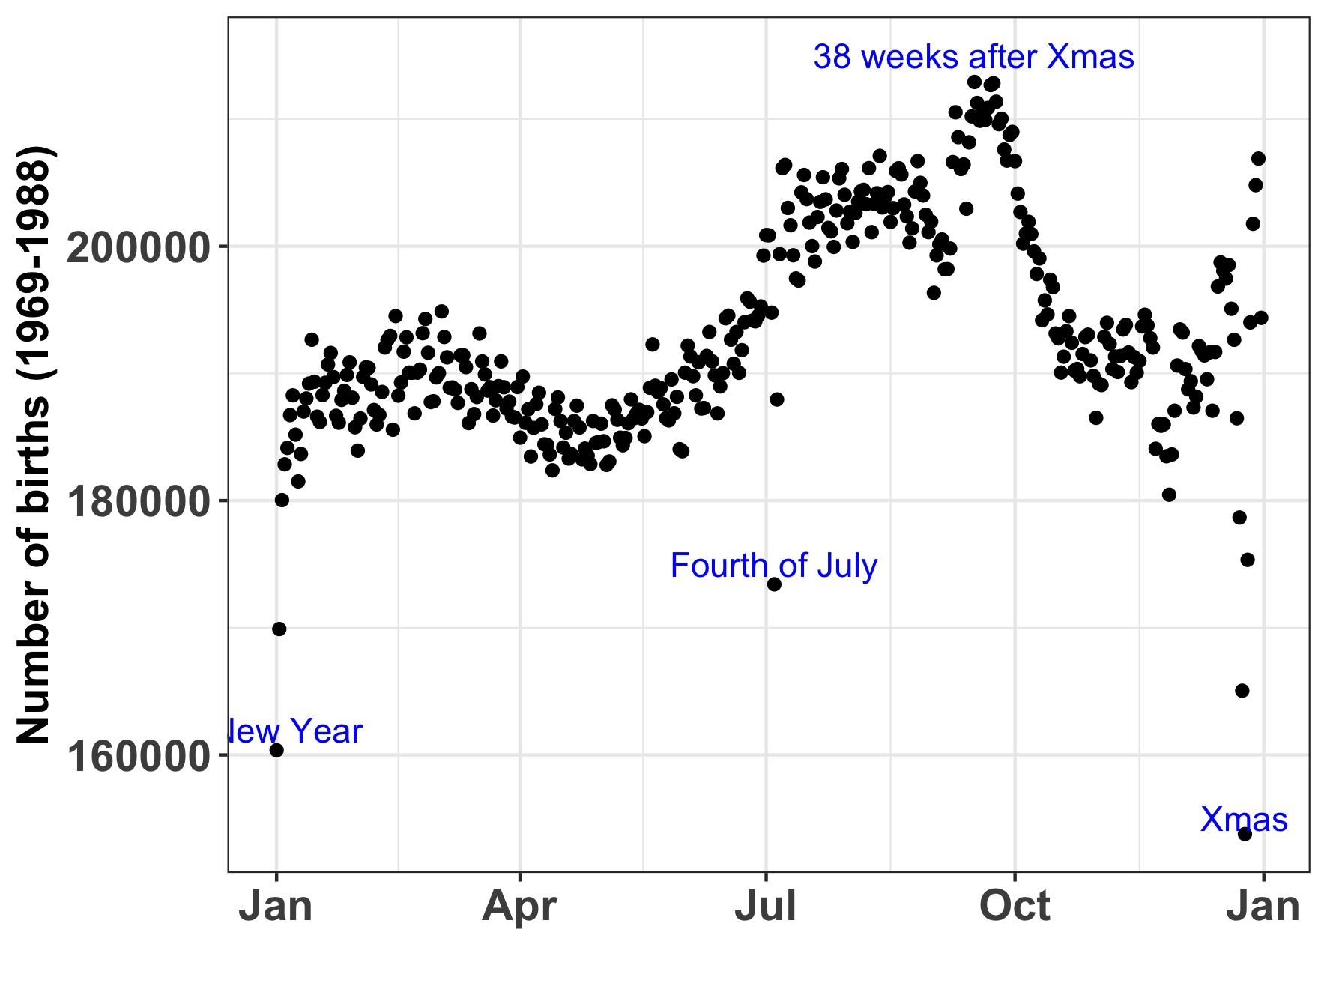
Is discrete time realistic for population growth?
Human births by day in the US
(1969-1988)
Notes:
Infanticide by mother vs. competition with other siblings. Safest to be harder to distinguish parentage apart

Slide 38
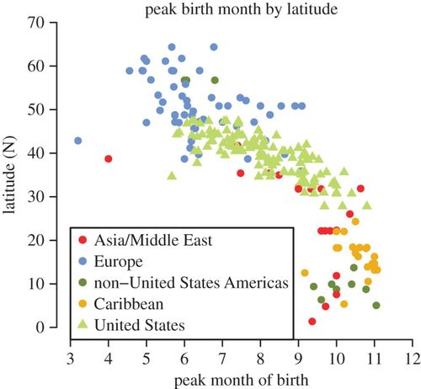
Is discrete time realistic for population growth?
Many populations (including human) are better approximated by an assumption of a continuous birth rate
Martinez-Bakker et al. 2014. Proc Roy Soc B.
Notes:
Infanticide by mother vs. competition with other siblings. Safest to be harder to distinguish parentage apart

Slide 39

What are the main assumptions of a simple population model?
Closed population
Homogenous mixing
Same birth and death rate for each person
What is lambda?
Population intrinsic growth rate

Slide 40
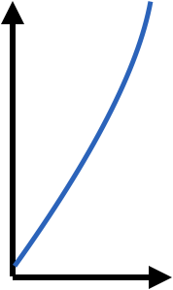
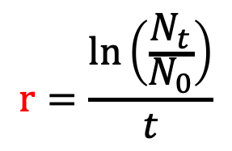
births
Madagascar
(N)
deaths
Geometric vs. exponential growth
Geometric growth
Exponential growth is measured in continuous time
$$r=\frac{\ln\left(\frac{N_{t}}{N_{0}}\right)}{t}$$
λ=N_{t+1}/N_{t}
population size, N_{t}
!as t→0
N₁= 𝜆N₀
N₂= 𝜆[𝜆N₀]=𝜆²N₀
N₃= 𝜆³N₀
N_{t}= 𝜆^{t}N₀
dN(t)/dt= rN(t)
λ=population rate of increase
r=intrinsic (instantaneous) rate of increase

Slide 41
births
Madagascar
(N)
deaths
Geometric vs. exponential growth
Discrete time
Continuous time
Continuous time
dN(t)/dt = rN(t)
Separation of variables:
dN(t)/N(t) = r dt
Integrate both sides:
∫ dN(t)/N(t) = ∫ r dt
By definition:
log(N(t)) = rt + c
Take exponentials:
N(t) = e^{rt + c} = Ce^{rt}
N(t) = N(0)e^{rt}
λ=N_{t+1}/N_{t}
N₁= 𝜆N₀
N₂= 𝜆[𝜆N₀]=𝜆²N₀
N₃= 𝜆³N₀
N_{t}= 𝜆^{t}N₀

Slide 42
Geometric vs. exponential growth
births
Madagascar
(N)
deaths
Discrete time
Continuous time
$$r=\frac{\ln\left(\frac{N_{t}}{N_{0}}\right)}{t}$$
λ=N_{t+1}/N_{t}
population size, N_{t}
!as t→0
N₁= 𝜆N₀
N₂= 𝜆[𝜆N₀]=𝜆²N₀
N₃= 𝜆³N₀
N_{t}= 𝜆^{t}N₀
N_{t} = N₀e^{rt}
λ=population rate of increase
r=intrinsic (instantaneous) rate of increase
(pop grows @ λ >1 & declines @ λ < 1 )
(pop grows @ r > 0 & declines @ r < 0 )

Slide 43
Geometric vs. exponential growth
geometric
N_{t}= 𝜆^{t}N₀
exponential
N_{t} = N₀e^{rt}
Discrete time
Continuous time
population size, N_{t}
population size, N_{t}

Slide 44
Geometric vs. exponential growth
geometric
N_{t}= 𝜆^{t}N₀
exponential
N_{t} = N₀e^{rt}
𝜆^{t}N₀ = N₀e^{rt}
Discrete time
Continuous time
population size, N_{t}
population size, N_{t}

Slide 45
Geometric vs. exponential growth
geometric
N_{t}= 𝜆^{t}N₀
exponential
N_{t} = N₀e^{rt}
𝜆^{t}N₀ = N₀e^{rt}
𝜆^{t} = e^{rt}
Discrete time
Continuous time
population size, N_{t}
population size, N_{t}

Slide 46
Geometric vs. exponential growth
geometric
N_{t}= 𝜆^{t}N₀
exponential
N_{t} = N₀e^{rt}
𝜆^{t}N₀ = N₀e^{rt}
𝜆^{t} = e^{rt}
𝜆 = e^{r}
Discrete time
Continuous time
population size, N_{t}
population size, N_{t}

Slide 47
Geometric vs. exponential growth
geometric
N_{t}= 𝜆^{t}N₀
exponential
N_{t} = N₀e^{rt}
Continuous models can be discretized.
Discrete models can be approximated in continuous time.
How to choose what to do?
The answer depends on the data and the question at hand!
𝜆^{t}N₀ = N₀e^{rt}
𝜆^{t} = e^{rt}
𝜆 = e^{r}
Discrete time
Continuous time
population size, N_{t}
population size, N_{t}

Slide 48
Geometric vs. exponential growth
geometric
N_{t}= 𝜆^{t}N₀
exponential
N_{t} = N₀e^{rt}
Continuous models can be discretized.
Discrete models can be approximated in continuous time.
How to choose what to do?
The answer depends on the data and the question at hand!
𝜆^{t}N₀ = N₀e^{rt}
𝜆^{t} = e^{rt}
𝜆 = e^{r}
Discrete time
Continuous time
population size, N_{t}
population size, N_{t}

Slide 49
Geometric vs. exponential growth
geometric
N_{t}= 𝜆^{t}N₀
exponential
N_{t} = N₀e^{rt}
Continuous models can be discretized.
Discrete models can be approximated in continuous time.
How to choose what to do?
The answer depends on the data and the question at hand!
𝜆^{t}N₀ = N₀e^{rt}
𝜆^{t} = e^{rt}
𝜆 = e^{r}
Discrete time
Continuous time
population size, N_{t}
population size, N_{t}

Slide 50
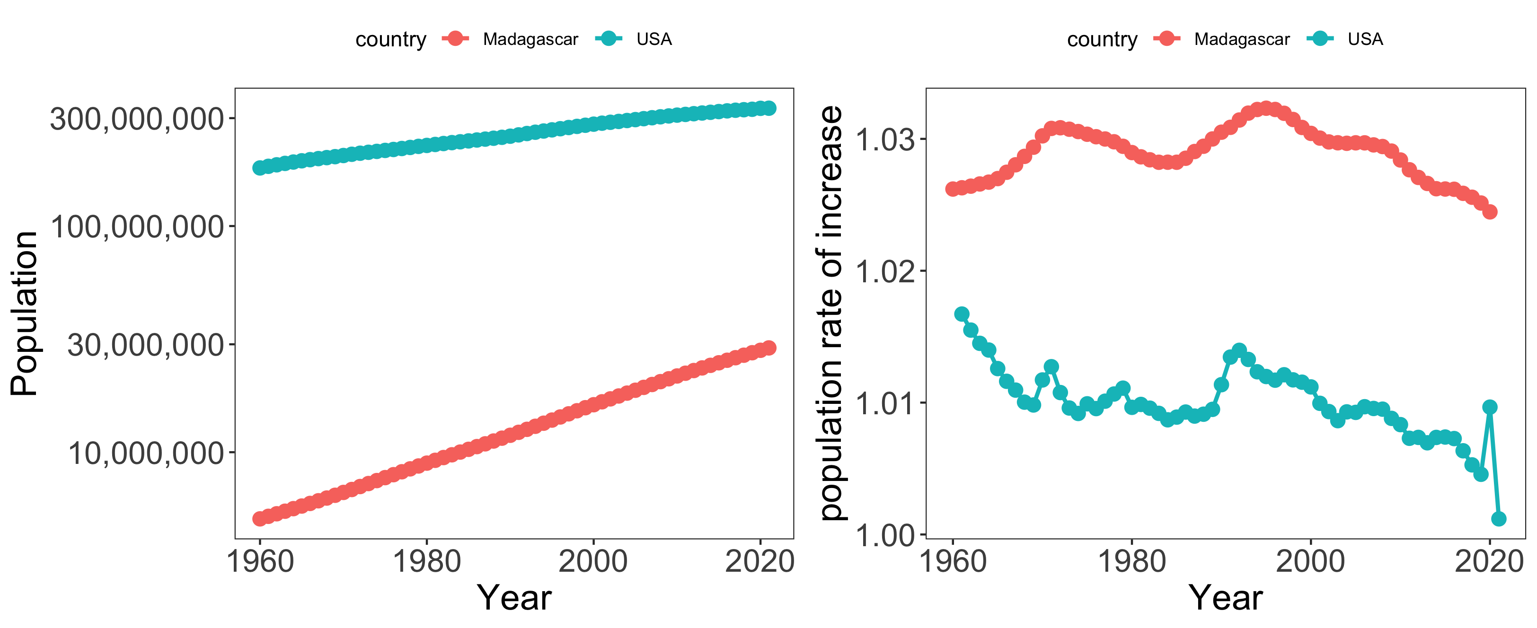
Geometric vs. exponential growth
Notes:
Remember our two countries

Slide 51
Geometric vs. exponential growth
λ=N_{t+1}/N_{t}
_{where t = 1 year}
Which country has the higher growth rate?
Notes:
Remember our two countries

Slide 52
Geometric vs. exponential growth
λ=N_{t+1}/N_{t}
Notes:
Population rate of increase per year – look at COVID in the US!

Slide 53
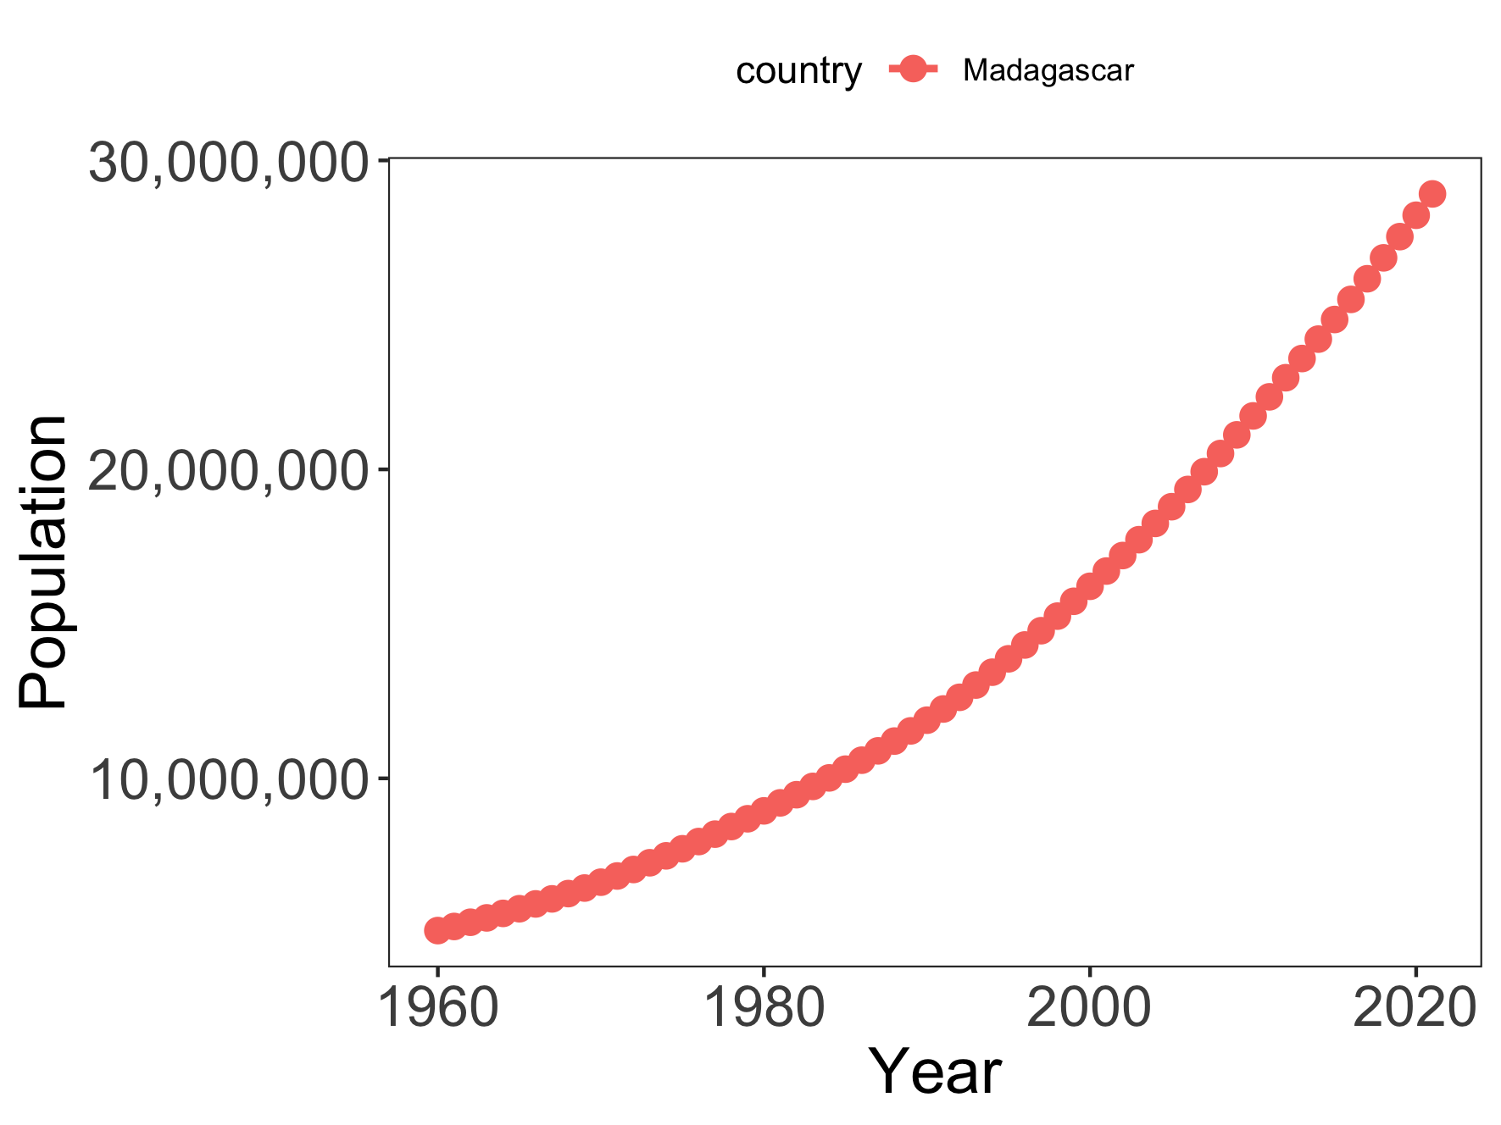
Geometric growth approximation of Madagascar’s population
λ=N_{t+1}/N_{t}
mean λ = 1.02
Notes:
They will diverge more quickly as the “timestep” gets larger

Slide 54
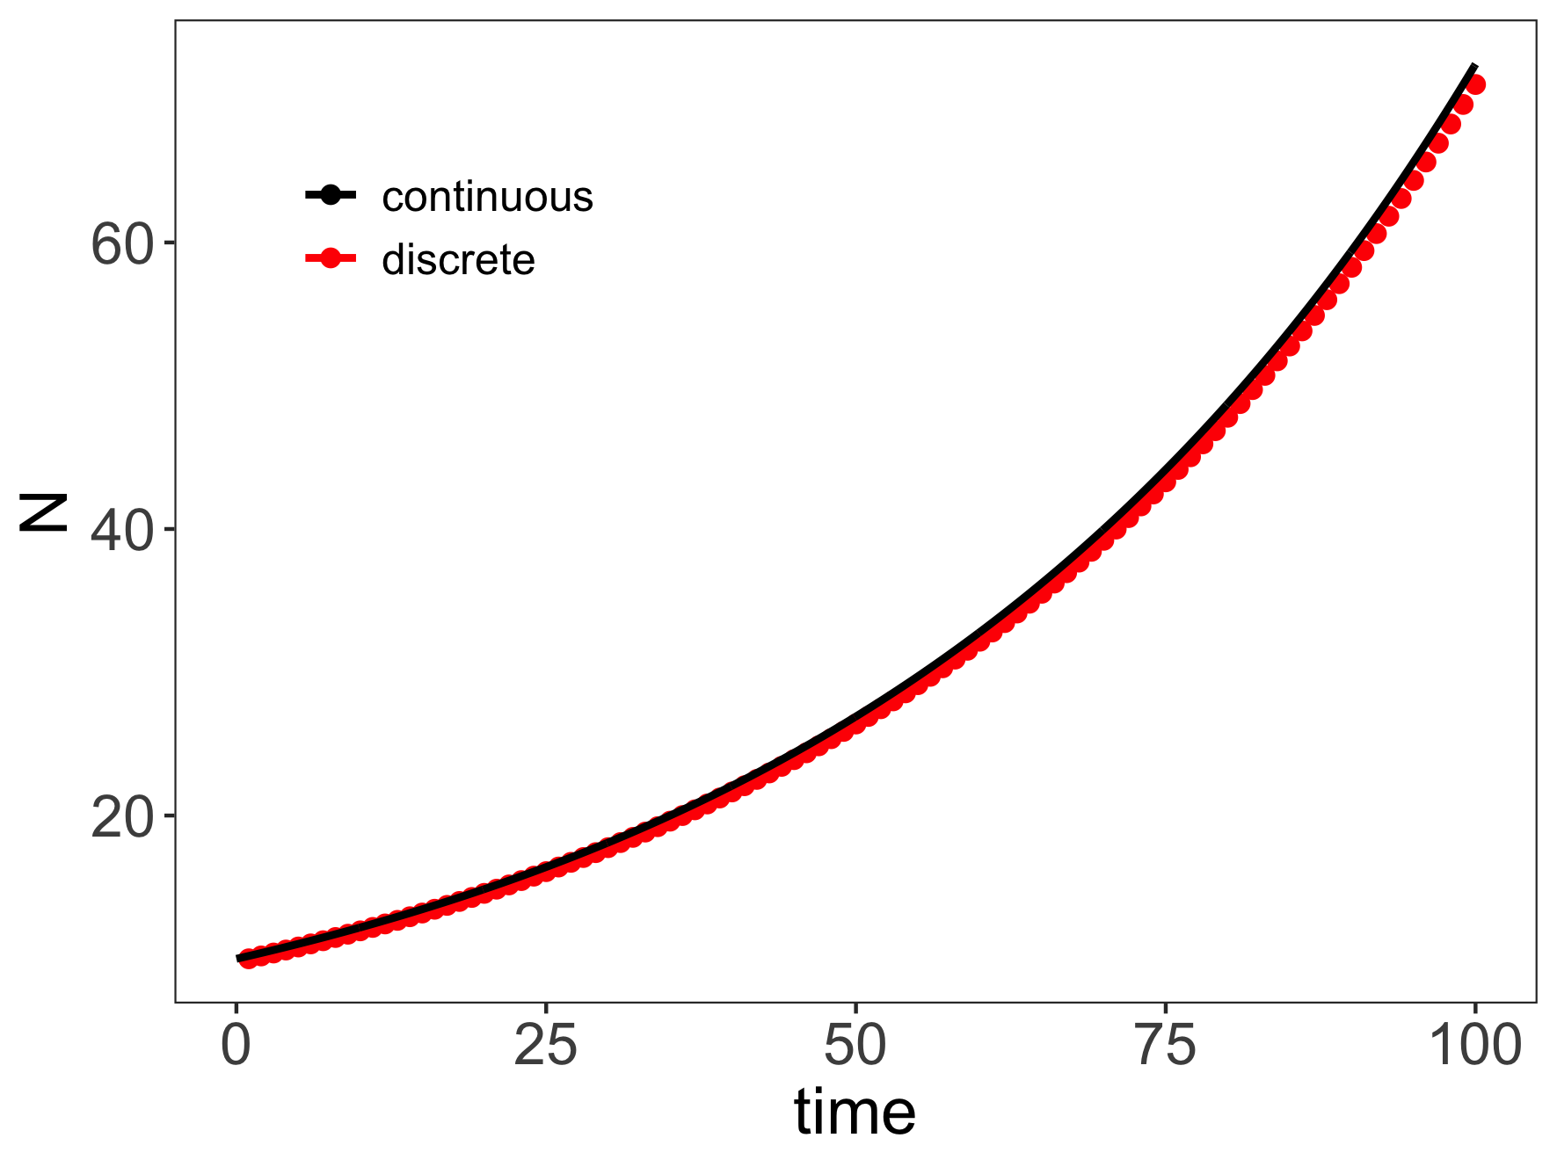
Projecting population under geometric vs. exponential growth
Geometric: λ = 1.02
Exponential: r = log(1.02) = 0.02
Models are similar over short time horizons and/or when discrete timesteps are small!

Slide 55

What is the difference between discrete and continuous models?
Discrete: state variable only changes at distinct geometric time steps
Continuous: state variables change continuously (tiny tiny time steps)
What math is used in discrete pop models? Continuous pop models?
Algebra, calculus

Slide 56
The basic
population model
births
Madagascar
(N)
deaths
What about those rates?
Are they the same every year?
And in every person? Why might they be different?
Reproductive age
Death rate increasing with age
Diseases/other health factors
How do we incorporate this ‘randomness’?
Notes:
We identified earlier that one of the key assumptions of this basic model so far is that the birth and death rates are constant. But is that the case in reality? What are some reasons that they might be different?
(reproductive age, death rate increases with age, health factors)
That question brings us to another key idea in compartmental modeling, deterministic vs stochastic models

Slide 57

The basic
population model
births
Madagascar
(N)
deaths
if deterministic
“always the same”
probability of death = 0.5
Notes:
Let’s use ducks as an example. Suppose we are looking at how the population of ducks changes over time, let’s say in discrete time of one year.
If we assume that the probability of death (i.e. the death rate) is constant, that means that we are absolutely sure that half of these ducks will die before the next year.

Slide 58

The basic
population model
births
Madagascar
(N)
deaths
if deterministic
“always the same”
probability of death = 0.5
Notes:
Leaving us with 5 ducks from our starting population of 10. this is an example of a deterministic model– our rates are fixed, constant, always the same, and we know exactly how the population changes year to year, every year.

Slide 59
The basic
population model
births
Madagascar
(N)
deaths
if deterministic
“always the same”
probability of death = 0.5
if stochastic?
“up to chance”
probability of death = 0.5
Notes:
But if we want our model to factor in some variation in the death rate (for the reasons we stated above) from year to year to try and be more realistic, we can use what’s called a stochastic model. Stochastic means ’up to chance’.
So let’s say in our stochastic model we start with the same 10 ducks, and the same probability of death

Slide 60

The basic
population model
births
Madagascar
(N)
deaths
if deterministic
“always the same”
probability of death = 0.5
if stochastic?
“up to chance”
probability of death = 0.5
Notes:
What we’ll see with a stochastic model is that some years, we get more death than the expected 0.5, and some years we get less. So in this case, we had a higher death rate (0.8), leaving us with only 2 surviving ducks.

Slide 61
The basic
population model
births
Madagascar
(N)
deaths
if deterministic
“always the same”
probability of death = 0.5
if stochastic?
“up to chance”
probability of death = 0.5
Notes:
What we’ll see with a stochastic model is that some years, we get more death than the expected 0.5, and some years we get less. So in this case, we had a higher death rate (0.8), leaving us with only 2 surviving ducks.

Slide 62
The basic
population model
births
Madagascar
(N)
deaths
if deterministic
“always the same”
probability of death = 0.5
rbinom(200,10,0.5)
if stochastic?
probability of death = 0.5
Notes:
Now the way that we do that is instead of having a fixed value of death rate (rate = 0.5 every year), we instead draw a value of the death rate from a distribution.
So each time point, we select some random value from this distribution that we use as our number of surviving ducks. Sometimes it is 5, sometimes it is more or less.

Slide 63
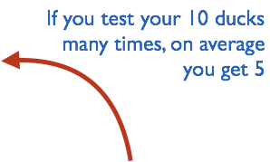
The basic
population model
births
Madagascar
(N)
deaths
if deterministic
“always the same”
probability of death = 0.5
rbinom(200,10,0.5)
if stochastic?
probability of death = 0.5
Notes:
Crucially though, on average, we get 5 surviving ducks, and that’s represented by the shape of this distribution. We are most likely to get 5 surviving ducks.

Slide 64
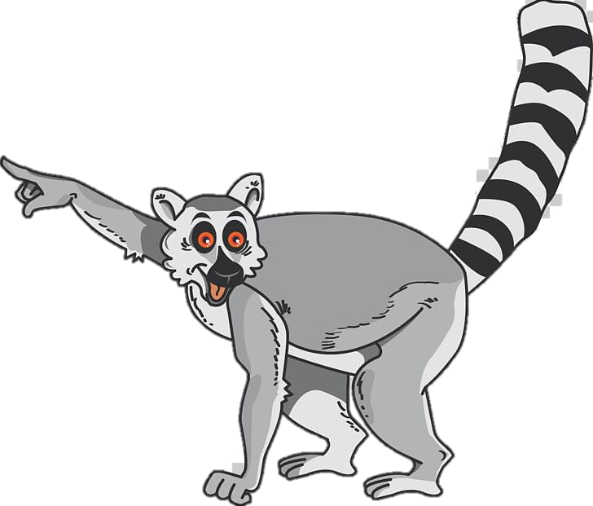
What is the difference between deterministic and stochastic?
Deterministic = always the same
Stochastic = up to chance
Notes:
Now we’re going to apply these concepts to more complex models, starting with structured population models.

Slide 65
Key concepts
Compartmental/mechanistic/mathematical models
Modèles en compartiments
Continuous vs. discrete models
Modèles en temps continue vs. modèles en temps discrète
Deterministic vs. stochastic models
Modèles détérministique vs. stochastique

Slide 66
2. Structured Population Models 2. Modèles de la population structurée

Slide 67
The structured
population model
births
Madagascar
(N)
deaths
data
Why does the model perform poorly?
model
population size, N_{t}
time
Notes:
Let’s go back to discrete time, and think about developing a model that describes the population of Ranomafana.
In this example, our data of real life counts of the population size are represented by red dots, and our estimate of the population size based on our simple discrete population model is represented by the blue line.
And we can see that the model doesn’t fit the data very well, i.e. the line doesn’t match up with the red dots.
we’ve touched on a few of these already, but what are some of the key assumptions of the simple population model that might make this projection so far off?
1) Time varying lambda 2) reproductive age.

Slide 68
The basic
population model
Why does the model perform poorly?
births
Madagascar
(N)
deaths
data
We need population structure!
That means distinguishing babies from adults.
model
population size, N_{t}
time
Notes:
In other words, we need population structure! In other words, we need a way to distinguish babies from adults, so that we can account for the fact that babies aren’t reproducing.

Slide 69
Modeling demographic complexity

Slide 70
Modeling demographic complexity
1. Populations are divided into compartments
2. Individuals within a compartment are homogenously mixed
3. Compartments and transition rates are
determined by biological systems
4. Rates of transferring between compartments
are expressed mathematically
births
Madagascar
(N)
deaths
The simplest
population model

Slide 71
Modeling demographic complexity
1. Populations are divided into compartments
2. Individuals within a compartment are homogenously mixed
3. Compartments and transition rates are
determined by biological systems
4. Rates of transferring between compartments
are expressed mathematically
births
Madagascar
(N)
deaths
What is wrong about this model?

Slide 72
Modeling demographic complexity
1. Populations are divided into compartments
2. Individuals within a compartment are homogenously mixed
3. Compartments and transition rates are
determined by biological systems
4. Rates of transferring between compartments
are expressed mathematically
births
Madagascar
(N)
deaths
What is wrong about this model?

Slide 73
Modeling demographic complexity
1. Populations are divided into compartments
2. Individuals within a compartment are homogenously mixed
3. Compartments and transition rates are
determined by biological systems
4. Rates of transferring between compartments
are expressed mathematically
Babies
Adults
The structured
population model

Slide 74
Modeling demographic complexity
1. Populations are divided into compartments
2. Individuals within a compartment are homogenously mixed
3. Compartments and transition rates are
determined by biological systems
4. Rates of transferring between compartments
are expressed mathematically
Babies
Adults
The structured
population model

Slide 75
Modeling demographic complexity
1. Populations are divided into compartments
2. Individuals within a compartment are homogenously mixed
3. Compartments and transition rates are
determined by biological systems
4. Rates of transferring between compartments
are expressed mathematically
births
Babies
aging
Adults
deaths
deaths
The structured
population model

Slide 76
The structured
population model
1. Populations are divided into compartments
2. Individuals within a compartment are homogenously mixed
3. Compartments and transition rates are
determined by biological systems
4. Rates of transferring between compartments
are expressed mathematically
Births (B)
Population rate of increase
Babies
aging (a)
Adults
λ=N_{t+1}/N_{t}
deaths (1-s_{b})
deaths (1-s_{a})
N_{t+1} = A* N_{t}
pop size at t
pop size at t + 1
matrix of survival and fecundity rates
vector of
population sizes
s_{b}(1-a)
B
s_{b}a
s_{a}

Slide 77
The structured
population model
1. Populations are divided into compartments
2. Individuals within a compartment are homogenously mixed
3. Compartments and transition rates are
determined by biological systems
4. Rates of transferring between compartments
are expressed mathematically
Births (B)
Population rate of increase
Babies
aging (a)
Adults
λ=N_{t+1}/N_{t}
deaths (1-s_{b})
deaths (1-s_{a})
N_{t+1} = A* N_{t}
pop size at t
pop size at t + 1
matrix of survival and fecundity rates
vector of
population sizes
s_{b}(1-a)
B
s_{b}a
s_{a}
*Discrete time

Slide 78
The structured
population model
1. Populations are divided into compartments
2. Individuals within a compartment are homogenously mixed
3. Compartments and transition rates are
determined by biological systems
4. Rates of transferring between compartments
are expressed mathematically
Births (B)
Babies
aging (a)
Adults
deaths (1-s_{b})
deaths (1-s_{a})
N_{t+1} = A* N_{t}
A
N_{t}
N_{t+1}
s_{b}(1-a)
B
N_{b}
s_{b}(1-a) N_{b} + BN_{a}
x
=
s_{b}a
s_{a}
N_{a}
s_{b} a N_{b} + s_{a}N_{a}

Slide 79
The structured
population model
1. Populations are divided into compartments
2. Individuals within a compartment are homogenously mixed
3. Compartments and transition rates are
determined by biological systems
4. Rates of transferring between compartments
are expressed mathematically
Births (B)
Babies
aging (a)
Adults
deaths (1-s_{b})
deaths (1-s_{a})
N_{t+1} = A* N_{t}
Population rate of increase
A
N_{t}
N_{t+1}
λ=dominant eigenvalue of transition matrix
s_{b}(1-a)
B
N_{b}
s_{b}(1-a) N_{b} + BN_{a}
x
=
s_{b}a
s_{a}
N_{a}
s_{b} a N_{b} + s_{a}N_{a}
Population growth will depend on population structure!
(pop grows @ λ >1 & declines @ λ < 1 )

Slide 80
Key concepts
Compartmental/mechanistic/mathematical models
Modèles en compartiments
Continuous vs. discrete models
Modèles en temps continue vs. modèles en temps discrète
Deterministic vs. stochastic models
Modèles détérministique vs. stochastique
Structured models
Modèles structurés.

Slide 81

How do we modify a basic population model to make it structured?
Two compartments (adults and babies)
Vector/matrix of values

Slide 82

3. SIR Models 3. Les modèles SIR

Slide 83
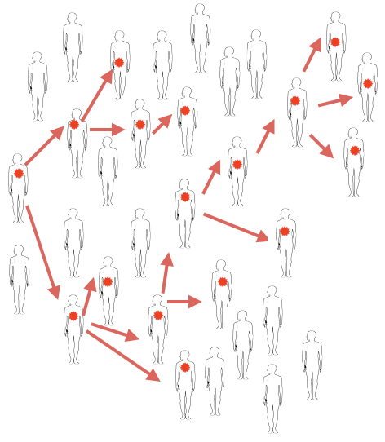
Notes:
SIR models aim to capture infection dynamics over time
This picture represents what a chain of transmission could look like , let’s say for measles through Antananarivo
Patient zero infects two people
Some infect more, some infect fewer

Slide 84
Infectious diseases: Some background terminology
Infection
Start of Symptoms
Incubation Period
Clinical Disease

Slide 85
Infectious diseases: Some background terminology
Latent Period
Infectious Period
Start of Shedding

Slide 86
Infectious diseases: Some background terminology
Infection
Start of Symptoms
Incubation Period
Clinical Disease
Latent Period
Infectious Period
Start of Shedding

Slide 87
Infectious diseases: Some background terminology
Infection
Start of Symptoms
Incubation Period
Clinical Disease
Latent Period
Infectious Period
Presymptomatic Infections
Start of Shedding

Slide 88
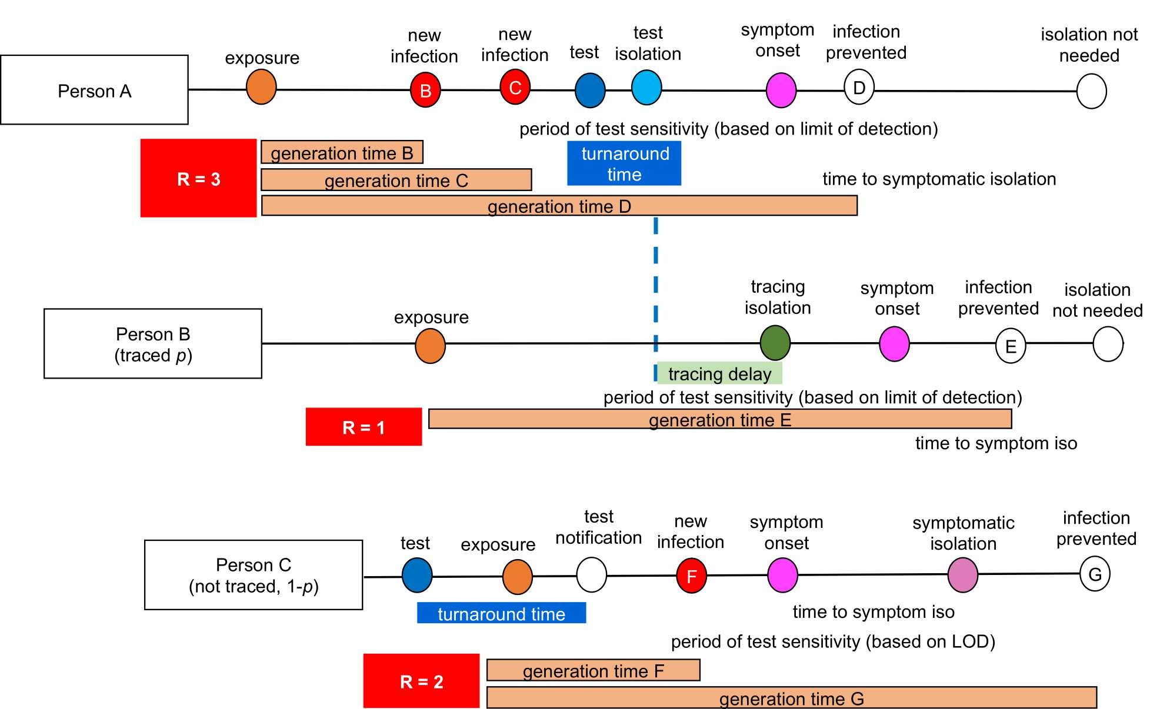
Infectious diseases: Some background terminology
Infection
Start of Symptoms
We used a model to understand the impact of surveillance testing on COVID transmission in a university setting.
Incubation Period
Clinical Disease
Latent Period
Infectious Period
Presymptomatic Infections
Start of Shedding
Brook et al. 2021. Epidemics.

Slide 89
Infectious diseases: Some background terminology
Infection
Start of Symptoms
Incubation Period
Clinical Disease
Latent Period
Infectious Period
Presymptomatic Infections
Start of Shedding
Let’s take a step back and think about acute, immunizing infections.

Slide 90
Infectious diseases: Some background terminology
Infection
Start of Symptoms
Incubation Period
Clinical Disease
Latent Period
Infectious Period
Presymptomatic Infections
Start of Shedding
Let’s take a step back and think about acute, immunizing infections.
pathogen lifespan < < < host lifespan

Slide 91
Infectious diseases: Some background terminology
Infection
Start of Symptoms
Incubation Period
Clinical Disease
Latent Period
Infectious Period
Presymptomatic Infections
Start of Shedding
Let’s take a step back and think about acute, immunizing infections.
infection induces antibody responses that prevent another infection
pathogen lifespan < < < host lifespan

Slide 92
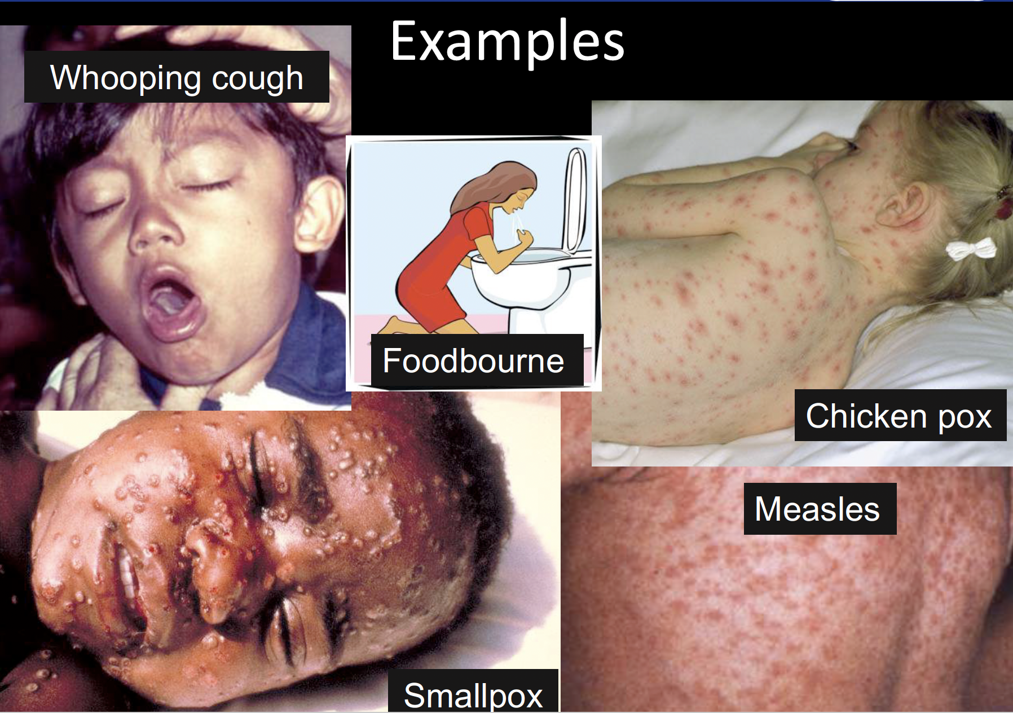
Acute, Immunizing Infections

Slide 93
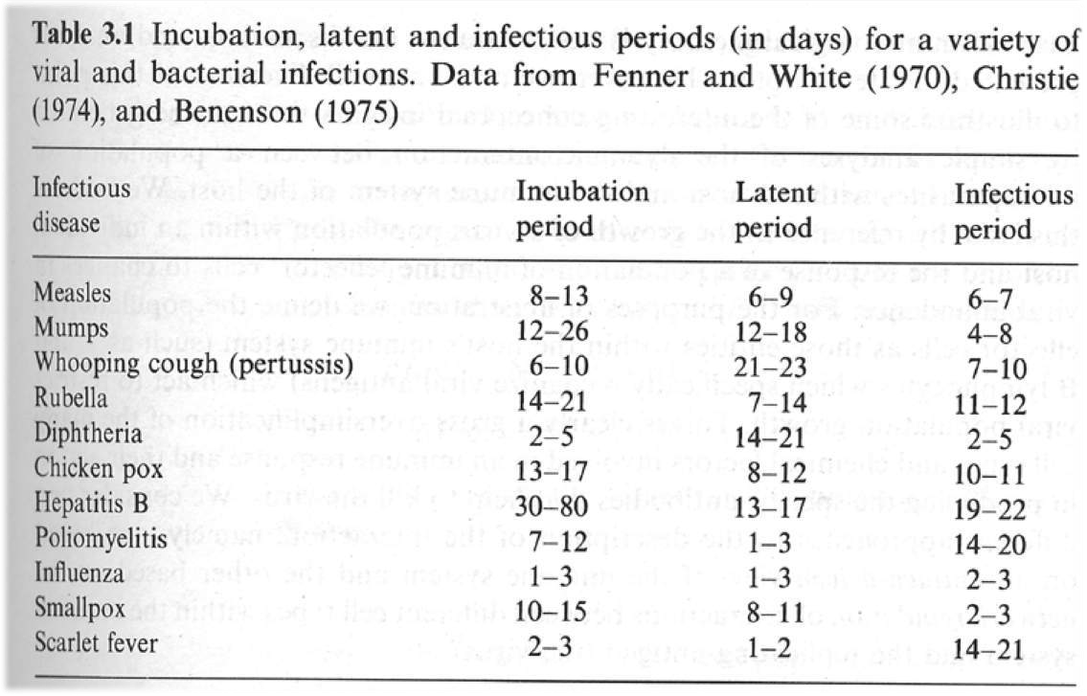
Acute, Immunizing Infections

Slide 94
Infectious diseases: Some background terminology
Infection
Start of Symptoms
Incubation Period
Clinical Disease
Latent Period
Infectious Period
Start of Shedding
Infected
Infectious
Diseased

Slide 95
Infectious diseases: Some background terminology
Infection
Start of Symptoms
Incubation Period
Clinical Disease
Latent
Infectious
asymptomatic infections
Start of Shedding
Infected
exposed but not yet infectious
A nuanced view
Infectious
Diseased
symptomatic but no longer infectious
symptomatic infections

Slide 96
Infectious diseases: Some background terminology
Latent
Infectious
Infection
Start of Shedding
Infected
A simpler view – ignore clinical signs
Infectious

Slide 97
Infectious diseases: Some background terminology
Infection
Infectious
Start of Shedding
Infected =
Infectious
An even simpler view – assume infectious immediately following exposure (contact)

Slide 98
Infectious diseases: Some background terminology
Infection
Susceptible
Infectious
Recovered
Start of Shedding
Susceptible
Infectious
Recovered
Health-related states = State variables

Slide 99
The SIR model
Compartmental models (Mechanistic Models)
1. Populations are divided into compartments
2. Individuals within a compartment are homogenously mixed
3. Compartments and transition rates are
determined by biological systems
4. Rates of transferring between compartments
are expressed mathematically
How does measles transmit through Paris?
Comment la rougéole se transmet-elle à Paris?
Notes:
When I say “build a model” I mean “create a stylized version of reality”. …Key to remember, all models are wrong - some models are useful…

Slide 100
The SIR model
Compartmental models (Mechanistic Models)
1. Populations are divided into compartments
2. Individuals within a compartment are homogenously mixed
3. Compartments and transition rates are
determined by biological systems
4. Rates of transferring between compartments
are expressed mathematically
susceptible
infectious
recovered
S
I
R

Slide 101
The SIR model
Compartmental models (Mechanistic Models)
1. Populations are divided into compartments
2. Individuals within a compartment are homogenously mixed
3. Compartments and transition rates are
determined by biological systems
4. Rates of transferring between compartments
are expressed mathematically
susceptible
infectious
recovered
S
I
R
What are the big assumptions here?
Notes:
Everyone is either SIR
Uniformly mixed
No latent period
Recovery is permanent
constant population size

Slide 102
The SIR model
Compartmental models (Mechanistic Models)
1. Populations are divided into compartments
2. Individuals within a compartment are homogenously mixed
3. Compartments and transition rates are
determined by biological systems
4. Rates of transferring between compartments
are expressed mathematically
everyone is either:
susceptible
infectious
recovered
S
I
R
What are the big assumptions here?

Slide 103
The SIR model
Compartmental models (Mechanistic Models)
1. Populations are divided into compartments
2. Individuals within a compartment are homogenously mixed
3. Compartments and transition rates are
determined by biological systems
4. Rates of transferring between compartments
are expressed mathematically
everyone is either:
susceptible
infectious
recovered
S
I
R
people mix uniformly (mass action)
les gens se mélangent uniformément

Slide 104
The SIR model
Compartmental models (Mechanistic Models)
1. Populations are divided into compartments
2. Individuals within a compartment are homogenously mixed
3. Compartments and transition rates are
determined by biological systems
4. Rates of transferring between compartments
are expressed mathematically
susceptible
infectious
recovered
S
I
R
infection
recovery
people mix uniformly (mass action)
no latent period
(infectious when infected)
les gens se mélangent uniformément
pas de période de latence

Slide 105
The SIR model
Compartmental models (Mechanistic Models)
1. Populations are divided into compartments
2. Individuals within a compartment are homogenously mixed
3. Compartments and transition rates are
determined by biological systems
4. Rates of transferring between compartments
are expressed mathematically
susceptible
infectious
recovered
S
I
R
recovery is permanent
infection
recovery
la récupération est permanente
people mix uniformly (mass action)
no latent period
(infectious when infected)
les gens se mélangent uniformément
pas de période de latence

Slide 106
The SIR model
Compartmental models (Mechanistic Models)
1. Populations are divided into compartments
2. Individuals within a compartment are homogenously mixed
3. Compartments and transition rates are
determined by biological systems
4. Rates of transferring between compartments
are expressed mathematically
population size constant - no births or deaths, migration
taille de population constante
susceptible
infectious
recovered
S
I
R
recovery is permanent
infection
recovery
la récupération est permanente
people mix uniformly (mass action)
no latent period
(infectious when infected)
les gens se mélangent uniformément
pas de période de latence

Slide 107
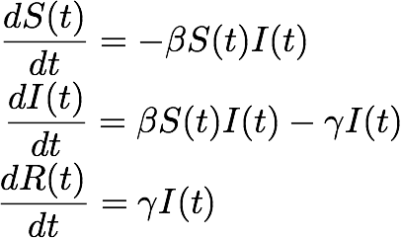
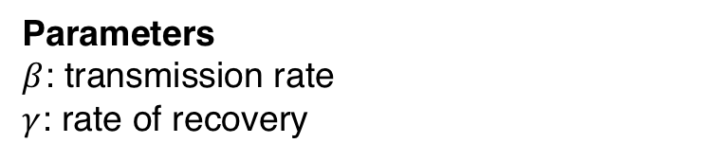
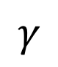
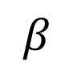
The SIR model
Compartmental models (Mechanistic Models)
1. Populations are divided into compartments
2. Individuals within a compartment are homogenously mixed
3. Compartments and transition rates are
determined by biological systems
4. Rates of transferring between compartments
are expressed mathematically
Parameters
$β$: transmission rate
$γ$: rate of recovery
susceptible
infectious
recovered
S
I
R
infection
recovery
$$β$$
$$γ$$
Notes:
Parameters
equations

Slide 108
The SIR model
Compartmental models (Mechanistic Models)
1. Populations are divided into compartments
2. Individuals within a compartment are homogenously mixed
3. Compartments and transition rates are
determined by biological systems
4. Rates of transferring between compartments
are expressed mathematically
Parameters
$β$: transmission rate
$γ$: rate of recovery
susceptible
infectious
recovered
S
I
R
transmission
recovery
$$β$$
$$γ$$
…infected numbers influence the transmission rate….

Slide 109
The SIR model
Compartmental models (Mechanistic Models)
1. Populations are divided into compartments
2. Individuals within a compartment are homogenously mixed
3. Compartments and transition rates are
determined by biological systems
4. Rates of transferring between compartments
are expressed mathematically
Parameters
$β$: transmission rate
$γ$: rate of recovery
susceptible
infectious
recovered
S
I
R
transmission
recovery
$$β$$
$$γ$$
What will the dynamics look like?

Slide 110
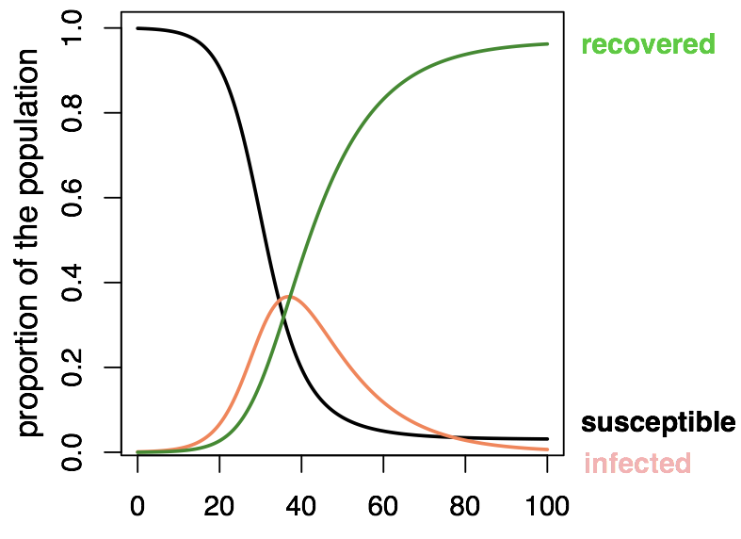
The SIR model

Slide 111
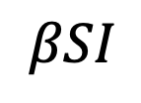
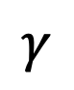
The SIR model
Set: I=1
I
transmission
recovery
$$βSI$$
$$γ$$
The average number of persons infected by an infectious individual when everyone is susceptible (S=100%, or S=1, start of an epidemic)
Notes:
Look just at the very start of an outbreak
Set I = 1, you can calculate a value for R0, which is:

Slide 112
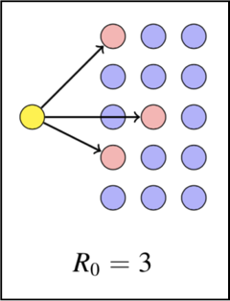
The SIR model
Notes:
For example,

Slide 113
The SIR model
Notes:
For example,

Slide 114
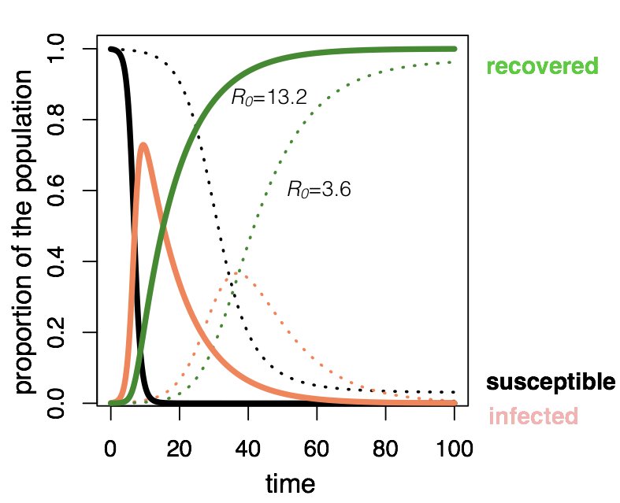
The SIR model
Which has the higher R0 value?
Notes:
High R0 (13.2) -- very fast infection
Lower R0 – slower infection

Slide 115
The SIR model
Notes:
High R0 (13.2) -- very fast infection
Lower R0 – slower infection

Slide 116
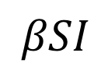
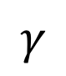
The SIR model
Set: I=1
I
transmission
recovery
$$βSI$$
$$γ$$
The average number of persons infected by an infectious individual when everyone is susceptible (S=100%, or S=1, start of an epidemic)
R_{E} =
“R-effective"
…as the epidemic progresses and S falls
Notes:
Back to SIR, and how an epidemic ends with some susceptibles still left over
Another value of R that’s important is R effective, which is R0 * S
Number of secondary infections at points in time other than just the initial outbreak stage
Changes throughout an epidemic as the value of S changes

Slide 117
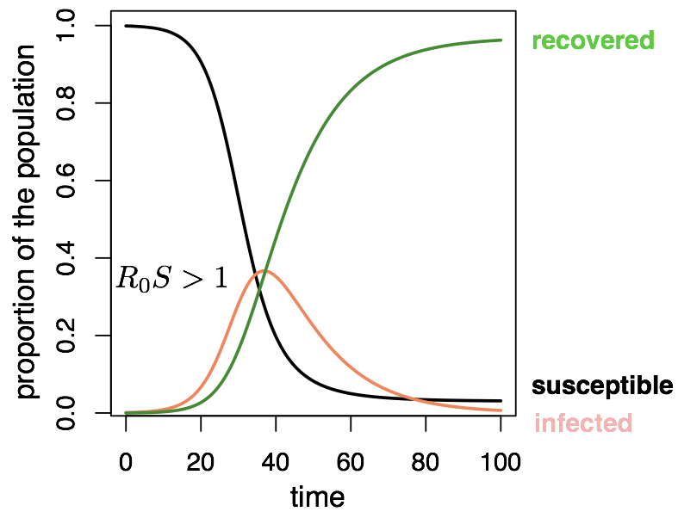
The SIR model

Slide 118
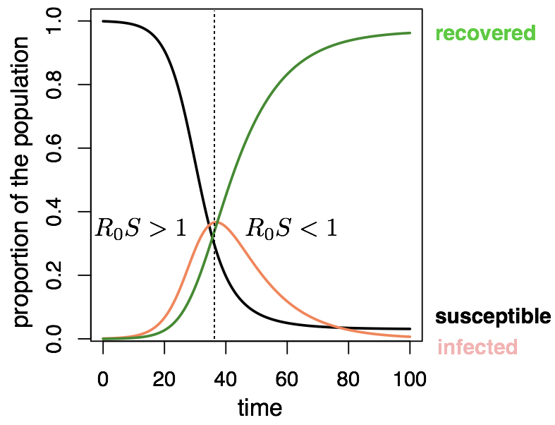
The SIR model
Notes:
When Re is < 1, cases fall eventually to 0

Slide 119


Slide 120
What is R0?

Slide 121
What is R0?
The average number of secondary infections from the first infectious individual in a naïve population

Slide 122
What is R0?
The average number of secondary infections from the first infectious individual in a naïve population
What is R_{E}?

Slide 123
What is R0?
The average number of secondary infections from the first infectious individual in a naïve population
What is R_{E}?
The average number of secondary infections from an infectious individual in a non-naïve population

Slide 124
What is R0?
The average number of secondary infections from the first infectious individual in a naïve population
What is R_{E}?
The average number of secondary infections from an infectious individual in a non-naïve population
How could you modify the simple SIR model to represent COVID-19?

Slide 125
The SIR model : vaccination
S
I
R
transmission
recovery
vaccination
Vaccination moves people out of susceptibles into the immune (recovered) class.
La vaccination éloigne les personnes sensibles de la maladie dans la classe immunitaire (rétablie).

Slide 126
The SIR model : vaccination
S
I
R
transmission
recovery
vaccination
Vaccination moves people out of susceptibles into the immune (recovered) class.
La vaccination éloigne les personnes sensibles de la maladie dans la classe immunitaire (rétablie).

Slide 127
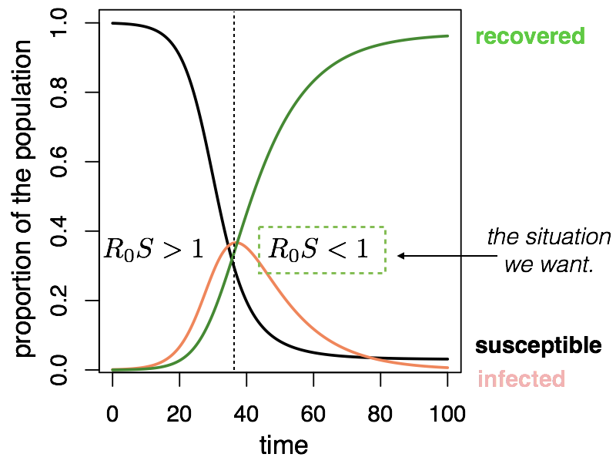
The SIR model : vaccination

Slide 128
The SIR model : vaccination
Proportion that needs to be vaccinated to interrupt transmission:
critical vaccination threshold

Slide 129
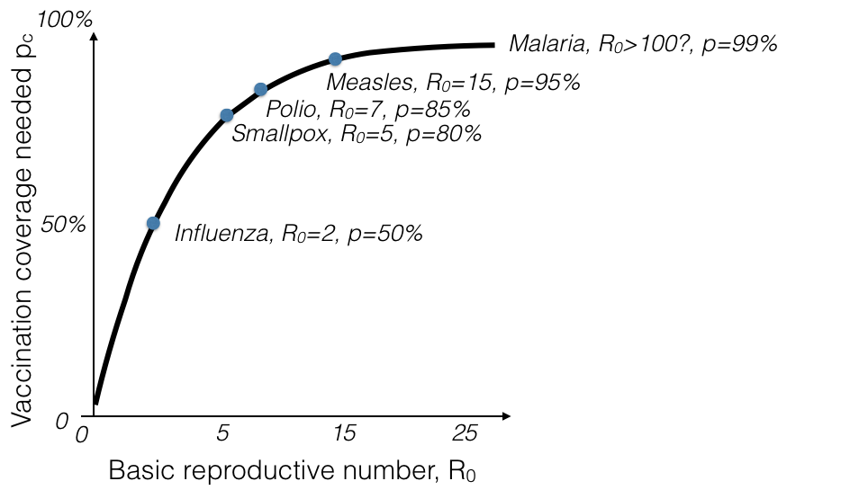
The SIR model : eradication
More transmissible diseases are harder to eradicate
Notes:
Look across different diseases

Slide 130
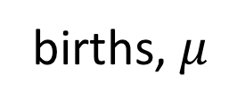
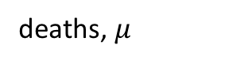
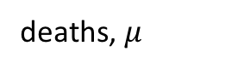

The SIR model : extensions
Moving beyond a ‘closed’ population
births, $μ$
transmission
recovery
S
I
R
vaccination, p
deaths, $μ$
deaths, $μ$
deaths, $μ$
Notes:
Births and deaths
vaccination

Slide 131
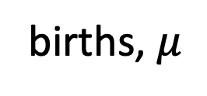
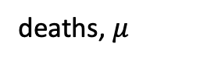
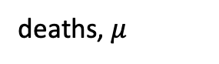
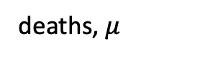
The SIR model : extensions
Moving beyond a ‘closed’ population
births, $μ$
transmission
recovery
S
I
R
vaccination, p
deaths, $μ$
deaths, $μ$
deaths, $μ$
Notes:
Births and deaths
vaccination

Slide 132
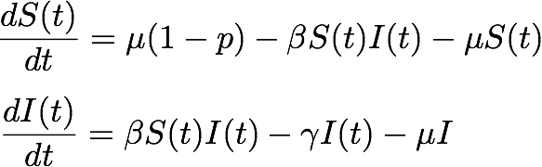
The SIR model : extensions
Moving beyond a ‘closed’ population
births, $μ$
transmission
recovery
S
I
R
vaccination, p
deaths, $μ$
deaths, $μ$
deaths, $μ$
Notes:
Show deaths
Show births
Show vaccinations

Slide 133
The SIR model : add births
Moving beyond a ‘closed’ population
births, $μ$
transmission
recovery
S
I
R
vaccination, p
deaths, $μ$
deaths, $μ$
deaths, $μ$
How will births impact dynamics?

Slide 134
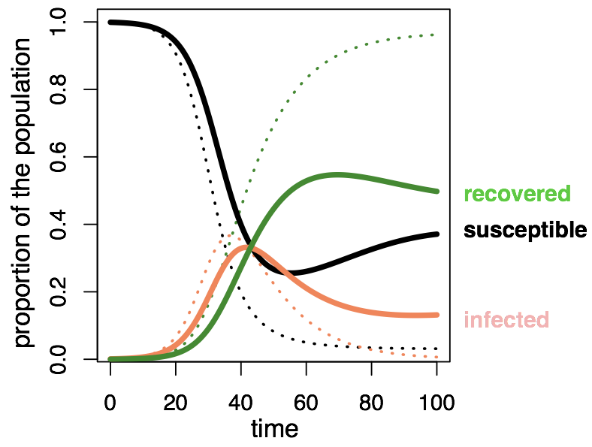
The SIR model : add births
Notes:
Births!
If we keep adding susceptibles to the population, infection will persist

Slide 135
Beyond the SIR model
births, $μ$
transmission
recovery
S
I
R
vaccination, p
deaths, $μ$
deaths, $μ$
deaths, $μ$
What do we change if infection is always FATAL?
Notes:
Guess?

Slide 136

Beyond the SIR model
births, $μ$
transmission
S
I
vaccination, p
deaths, $α$
deaths, $μ$
deaths, $μ$
What do we change if infection is always FATAL?
Notes:
Instead of recovered class, we remove it entirely and infectious individuals are lost from the population

Slide 137
Beyond the SIR model
births, $μ$
transmission
recovery
S
I
R
vaccination, p
deaths, $μ$
deaths, $μ$
deaths, $μ$
What if immunity wanes?

Slide 138
Beyond the SIR model
waning immunity
births, $μ$
transmission
recovery
S
I
R
vaccination, p
deaths, $μ$
deaths, $μ$
deaths, $μ$
What if immunity wanes?

Slide 139
Beyond the SIR model
births, $μ$
transmission
recovery
S
I
R
vaccination, p
deaths, $μ$
deaths, $μ$
deaths, $μ$
What if people recover at different rates?

Slide 140
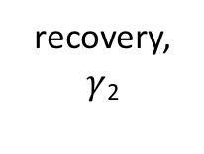
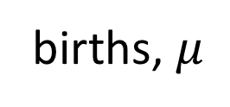
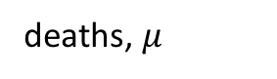




Beyond the SIR model
births, $μ$
transmission
recovery, $γ$₁
vaccination, p
S
I₁
R
deaths, $μ$
deaths, $μ$
deaths, $μ$
transmission
I₂
recovery, $γ$₂
deaths, $μ$
What if people recover at different rates?

Slide 141
Key concepts
Compartmental/mechanistic/mathematical models
Modèles en compartiments
Continuous vs. discrete models
Modèles en temps continue vs. modèles en temps discrète
Deterministic vs. stochastic models
Modèles détérministique vs. stochastique
Structured models
Modèles structurés.
Two population models
Modèles des deux populations
SIR models – and beyond!
Modèles SIR – et au délà!

Slide 142

“All models are _____, some models are_____.”

Slide 143

Which model?
Notes:
and the point will be it depends on the question.
https://www.ncbi.nlm.nih.gov/pmc/articles/PMC2566243/

